Slide 1
Digital Image Processing
Final Project: Morphology
Team A9:
Ijeriedumare Omitogun
Kunle Eniola
Nicholas Vu
Caleb Osborn
Eric Jiang

Slide 2
Objectives
Identify the effects of morphological operations on an image
Provide visual reference of the changes (logical operators)
Single & compound operations
Blob counting on output image to show changes numerically
Compare how the window shape/size affects the outcome
Implement functions
Erode
Dilate
Open, close, open/close, close/open
Skeletonization
Boundary extraction

Slide 3
Member Responsibility
Ijeriedumare Omitogun
Erosion / Dilution
Open / Close
Kunle Eniola
Boundary Extraction
Nicholas Vu
Erosion / Dilution
Open / Close
Caleb Osborn
GUI / Boundary Extraction
Eric Jiang
Skeletonization

Slide 4



Libraries
Tkinter
GUI implementation
OpenCV
Image load, minor operations
NumPy
Matrix/array arithmetic

Slide 5
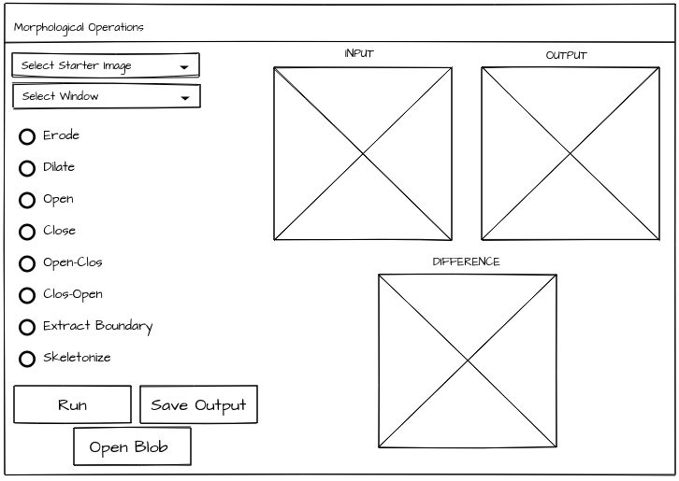
GUI

Slide 6
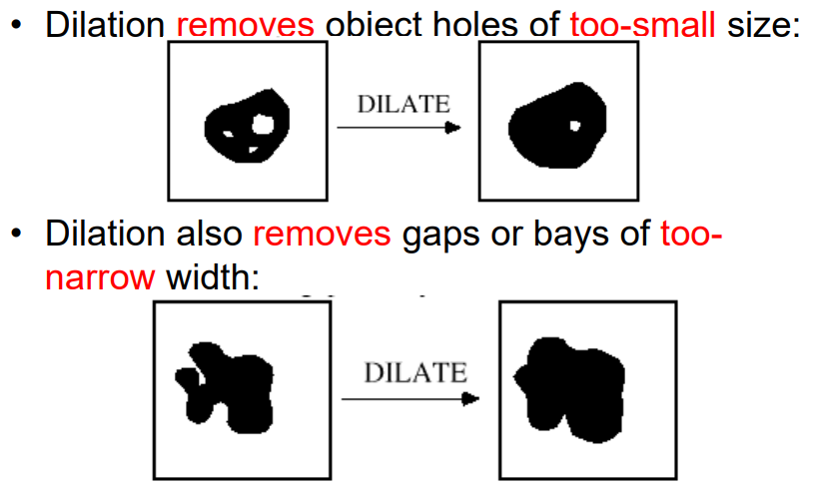
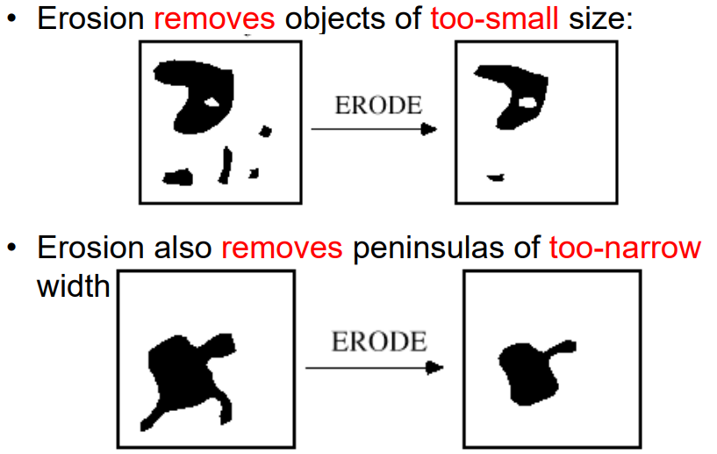
Erosion and Dilation
Erosion - The basic effect of the operator on a binary image is to erode away the boundaries of regions of foreground pixels (i.e. white pixels, typically). Thus areas of foreground pixels shrink in size, and holes within those areas become larger.
Dilation - The basic effect of the operator on a binary image is to gradually enlarge the boundaries of regions of foreground pixels (i.e. white pixels, typically). Thus areas of foreground pixels grow in size while holes within those regions become smaller.

Slide 7
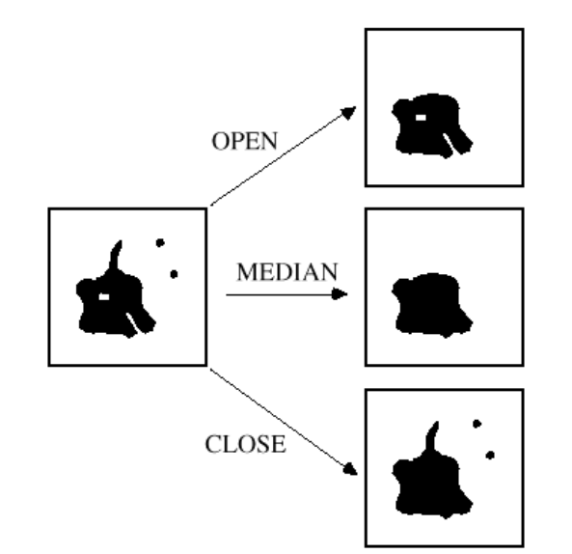
Opening and Closing
OPEN removes too-small objects/fingers, but not holes, gaps, or bays
CLOSE removes too-small holes/gaps but not objects or peninsulas
OPEN and CLOSE generally do not affect object size

Slide 8
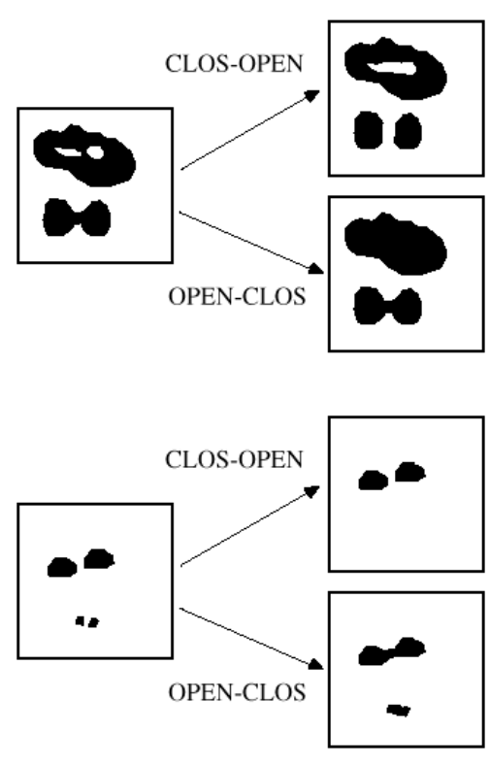
Open-Close and Close-Open
CLOS-OPEN tends to link neighboring holes together
OPEN-CLOS tends to link neighboring objects together

Slide 9
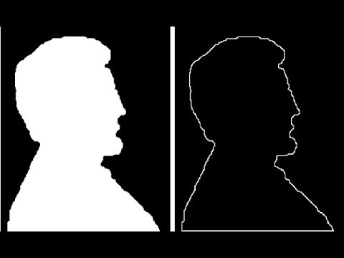
Boundary Extraction
Extract the outermost pixels from a desired image object and use them to recreate the outline of the object.

Slide 10


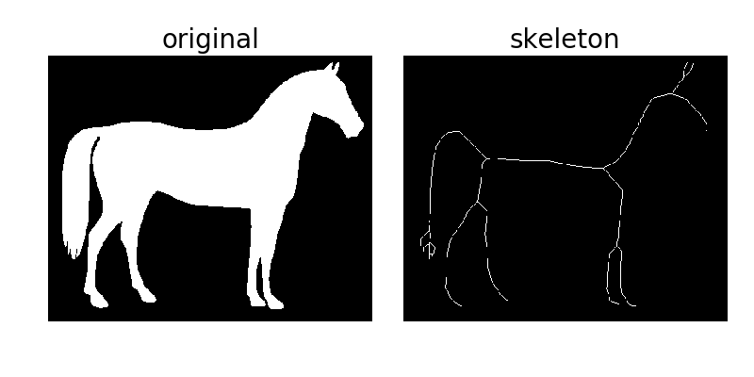

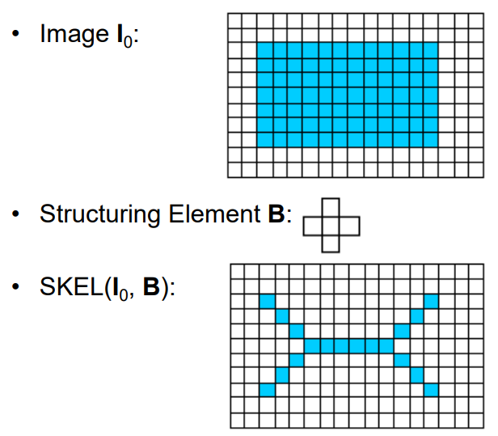


Skeletonization
binarize
Obtain an image’s medial axis (skeleton) by thinning the image until the area of interest is 1 pixel wide
Controlled iterations of erosions
Preserves topology
skeletonize

Slide 11
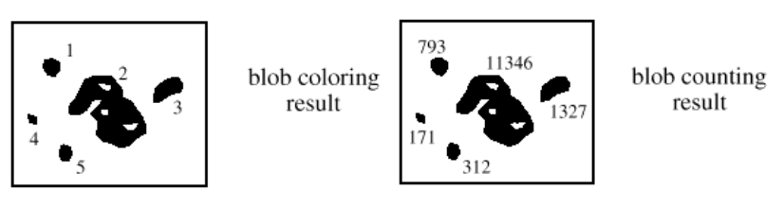
Blob Coloring
Visually and numerically identify the changes an operation makes on an images blobs

